Slide 1
Machine Learning in Business
Chapter 7: Further Applications of Neural Networks

Slide 2
Autoencoders
An autoencoder is designed to copy the input to the output
The objective is similar to PCA: to find a small number of features that capture nearly all the properties of the data
The weights are choses to minimize the sum of squared differences between the output and the input

Slide 3
Using an autoencoder for interest rates

Slide 4
Results
An autoencoder with linear activation functions produces an equivalent result to PCA
The PCA factors are uncorrelated and easier to use
But autoencoders can use non-linear activation functions
They have been found to be useful in language translation and image recognition

Slide 5
Possible architecture for more general auto-encoder with non-linear activation functions
Latent variables representing inputs
Hidden layer
Hidden layer
Hidden layer
Hidden layer
Inputs
Outputs

Slide 6
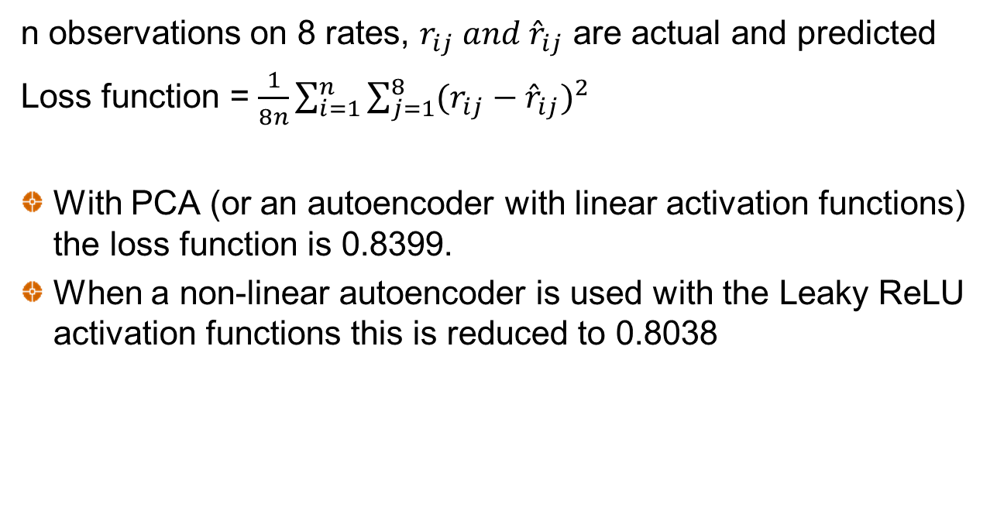
Results
n observations on 8 rates, $r_{ij} and {\hat{r}}_{ij}$ are actual and predicted
Loss function = $\frac{1}{8n}\sum_{i=1}^{n}{\sum_{j=1}^{8}{{(r_{ij}−{\hat{r}}_{ij})}^{2}}}$
With PCA (or an autoencoder with linear activation functions) the loss function is 0.8399.
When a non-linear autoencoder is used with the Leaky ReLU activation functions this is reduced to 0.8038

Slide 7
Creating Synthetic Data
Two approaches:
Variational Autoencoders
Generative Adversarial Networks

Slide 8
Variational Autoencoder

Slide 9
Generative Adversarial Network

Slide 10
Recurrent Neural Network (RNN)
In a vanilla ANN, the v’s are functions of the inputs and the sequence of the inputs does not matter
In a recurrent neural network there is a time dimension to the data. The current v’s are made functions of the corresponding previous v’s (or possibly previous outputs) as well as current inputs

Slide 11
Recurrent Neural Network Design

Slide 12
LSTM Network
A long short-term memory (LSTM) network is a type of RNN where part of the algorithm learns what should be remembered and what should be forgotten from previous data

Slide 13
Convolutional Neural Network (CNN)
In a vanilla ANN the layers are fully connected which can give rise to a very large number of parameters
In a convolutional neural network, the number of neurons in one layer that affect the next layer is reduced.
Used for image recognition where each pixel can be a feature
Consistent with the way neurons in the eye work

Slide 14
A “receptive field” in input layer determines value at a neuron in “feature map” of first hidden layer

Slide 15
CNN: More Details
There are several layers as in a regular neural network
Each layer is actually three-dimensional consisting of several two-dimensional feature maps
For each feature map, biases and weights are the same across all receptive fields
There may be “padding” where extra observations are added at the edges to avoid successive layers becoming smaller

Slide 16
CNN: Key Advantages
Consider a image that is 100×100 or 10,000 pixels
A regular neural network would lead to 10,000×(10,000+1) or about 100 million parameters to define the first layer.
If a CNN’s receptive field is 10×10 and a layer has 6 feature maps only 6×101=606 are required
More importantly, once the CNN has learned to recognize a pattern in one location it can recognize it in another location.

Slide 17
Convolutional Neural Network Design

Slide 18
Application to Time Series
A CNN can be used to look for patterns in time series
The receptive field is one-dimensional, consisting of acertain number of consecutive observations
For example with 500 daily observations we could have a receptive field for Days 1 to 4, Days 2 to 5, Days 3 to 6, … Days 497 to 500

